Slide 1
Bitcoin Price prediction using ARIMA and RNN CSC 8810 - Computational Intelligence
Presenters: Rishinya Ravipati Praneetha Thotakura

Slide 2
AGENDA
Motivation
Previous research
Proposed methods
Project overview
Research Papers
Data Preprocessing
ARIMA Overview
ARIMA Implementation
ARIMA results
RNN, LSTM and GRU Overview
RNN Implementation
RNN Results
Future scope

Slide 3

MOTIVATION
Machine learning has been successful in predicting stock market prices but its application in predicting cryptocurrency prices has been quite restrictive.
Their high volatility leads to the great potential of high profit if intelligent inventing strategies are taken.
Unfortunately, due to their lack of indexes, cryptocurrencies are relatively unpredictable compared to traditional financial predictions like stock market prediction.
“The importance of having these bitcoin price prediction models is that they can have significant economic ramifications by helping investors and traders to pinpoint cryptocurrency sales and purchasing.”

Slide 4
PREVIOUS RESEARCH
Many experiments were organized in determining the fluctuation of the Bitcoin price prediction using various methodologies among which one is said to be Time series Analysis.
At last, one of the authors named Kim discovered the movement in the price by using few techniques like Neural Networks and Linear SVM.
He had worked over two months in identifying the fluctuations of the bitcoin price and the news related to the raise in the price of bitcoin.
Shortcomings: Among these techniques the SVM had given the 65.03% accuracy despite of neural networks.

Slide 5
PROPOSED METHODS
ARIMA:
Autoregressive integrated moving average (ARIMA) is generally used to depict the future data points on a time scale.
The major benefit of this model is that this might be used in circumstances when the data is non-stationary.
In the ARIMA model, integration means that the data values have been replaced by the discrepancy among their present value and the cumulative values.
RNN:
Recurrent Neural Networks (RNN) or Long Short- Term Memory (LSTM) where these are type of RNN, but they vary from ordinary neural network across its internal storage or hidden state.
RNN provides the outcome based on the past input and its context.
Gated Recurrent Units (GRUs) are among the strongly connected versions of sophisticated recurrent units.

Slide 6
PROJECT OVERVIEW
The datasets are taken from the Kaggle website which is almost valid for crypto exchange in few countries.
For training and testing process, we determined the methodologies like Recurrent Neural Networks with LSTM and GRU i.e., sequence to sequence and ARIMA.
We would also like to show the plots which compares the estimated prices and the actual price.
Not only the comparison between the prices, we have also determined the bitcoin price prediction in certain year that varies from month-to-month.

Slide 7
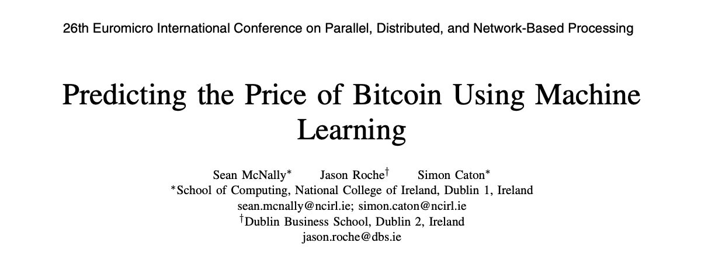
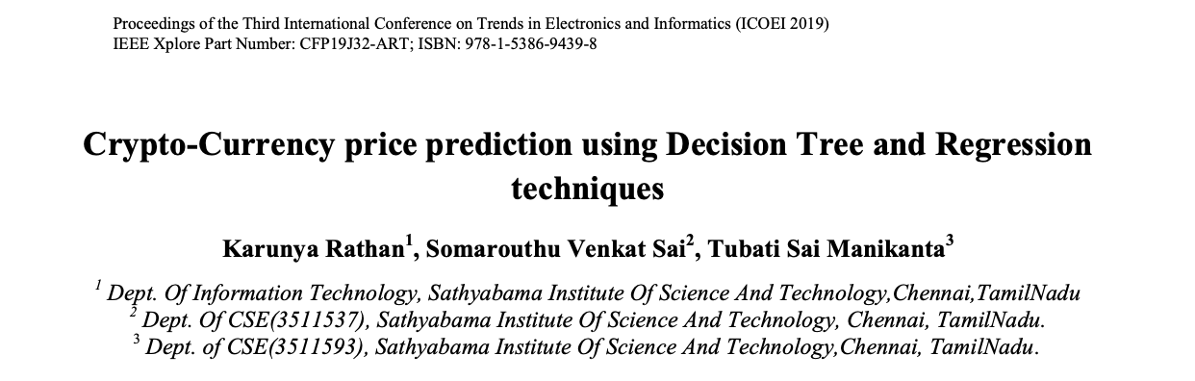
RESEARCH PAPERS
The previous research papers existing on this topic have no proper standard models as the problem involves prices which are changing with time.
This is because of solving the problem as a normal machine learning problem with the features being the previous prices and the output being the price predicted for that day.
Instead, it should be modelled as a series prediction problem.
We took this as the foundation and it became the idea behind our project.

Slide 8
DATA PRE-PROCESSING
Firstly, The packages are imported and dataset is imported.
The timestamp values are not humanly readable. So, they are converted into a normal date first.
After this timestamp column is dropped and replaced by date column.
There are few NAN values and we don’t want to drop those values. Since it is a time series data, we need to be extremely careful how we handle these values.
There are two options: Fill the missing values with previous values (forward fill) Fill the missing values with future values (backward fill).
We chose Forward Fill.
After this, the dataset is split into training and testing datasets based on the ARIMA and RNN Models.

Slide 9
ARIMA
Autoregressive integrated moving average (ARIMA) is a statistical regression model, which can be utilized in time series forecasting applications, such as finance.
ARIMA makes predictions while considering the lagged values of a time series, while accommodating for non-stationarity.
The model, which is one of the most popular linear models for time series forecasting, originates from the autoregressive (AR) and moving average (MA) models, as well as their combination, also known as ARMA.
For making predictions with the ARIMA model, we had to follow a step-by-step procedure to be able to feed the data to the ARIMA model.
The first step involves visualizing the time series data: It is essential to analyze the trends prior to building any kind of time series model.
Although the ARMA model can generally only be applied to stationary time series, non-stationary time series can be converted to stationary using the dth differentiation process.

Slide 10
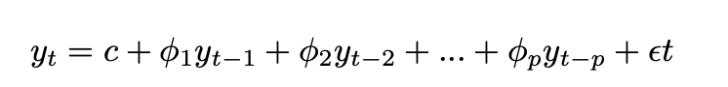
ARIMA (…contd)
Let y1, ..., yt define a univariate time series, with each yiεR.
An AR model of order p, denoted as AR(p), the current (predicted) value of a time series is expressed as follows:
where c is a constant, φ1 , ..., φp are the parameters of the model and εt is a variable producing white noise.
Consequently, an ARIMA model with parameters p, d, q, denoted as ARIMA(p, d, q), performs d differentiations to the original time series values, i.e., yt is converted to y.
The full ARIMA(p, d, q) is defined as follows:

Slide 11
ARIMA IMPLEMENTATION
Step 1: Dataset Used:
We have taken our dataset from Kaggle website.
Bitcoin exchanges are for the time period of Jan 2012 to July 2018, with minute to minute updates of OHLC (Open, High, Low, Close), Volume in BTC, indicated currency and weighted bitcoin price.
Time-stamps are in Unix time.
Time-stamps without any trades or activity have their data fields forward filled from the last valid time period.
Notes:
Unix time is a way of representing a timestamp by representing the time as the number of seconds since January 1st, 1970 at 00:00:00 UTC. One of the primary benefits of using Unix time is that it can be represented as an integer making it easier to parse and use across different systems.

Slide 12
ARIMA IMPLEMENTATION ( …contd)
Step 2: Converting Dataset into Workable Schema:
The dataset used in our research is indexed by time-stamps (minute by minute for 7 years), this leads to very large number of transaction (around 3405857 rows).
We tried to converted them to Day-to-Day indexed dataset, Monthly indexed dataset, Quarterly indexed dataset, and yearly dataset by taking Statistical Average of the Time-stamped value for the desired period.
After analyzing these newly created dataset, we concluded that monthly-indexed dataset is perfect for our research as it don’t lose any granular pattern and doesn’t over emphasize any irrelevant variation in our dataset.

Slide 13
ARIMA IMPLEMENTATION ( …contd)
Step 3: Stationarize the Dataset:
Now, in order to produce good results from our Statistical ARIMA model, we need to stationarize our dataset.
This data pre-processing work can be done by performing various transforms on our dataset.
Moreover, in order to validate whether our dataset is stationary or not, we have used Dickey–Fuller test.
Dickey–Fuller test tests the null hypothesis that a unit root is present in an autoregressive time series model.
In order to stationarize the dataset, we have used a variety of transforms. We can use many transform like Cox-Box, Seasonal differentiation, and Regular Differentiation for this purpose.
In our research, we applied them in the sequence mentioned above and we were able to successfully stationarize our dataset with a Dicky Fuller test value of 0.003063.

Slide 14
ARIMA IMPLEMENTATION ( …contd)
Step 4: Training ARIMA model:
The statistical ARIMA model accepts 3 parameters which are defined below:
Lag Order (p):Number of lag observations included in the model.
Degree Of Differencing (d): Number of times that the raw observations are differenced.
Order Of Moving Average (q): Size of the moving average window.
In order to get the best model for our research, we trained our model for various values of (p,d,q) and then chosen the model according to AIC value.
Akaike Information Criterion (AIC) is an estimator of the relative quality of statistical models for a given set of data. Given a collection of models for the data, AIC estimates the quality of each model, relative to each of the other models. Thus, AIC provides a means for model selection.
Given a set of candidate models for the data, the preferred model is the one with the minimum AIC value.
Thus, AIC rewards goodness of fit, but it also includes a penalty that is an increasing function of the number of estimated parameters.

Slide 15
ARIMA IMPLEMENTATION ( …contd)
Step 5: Prediction of Bitcoins:
The value predicted by our model will be in another value-range because we have done 3 transformation on it.
Now, in order to get the value in the required range we need to inverse those transforms and the value outputted by the inverse transforms is the predict value of the model.

Slide 16
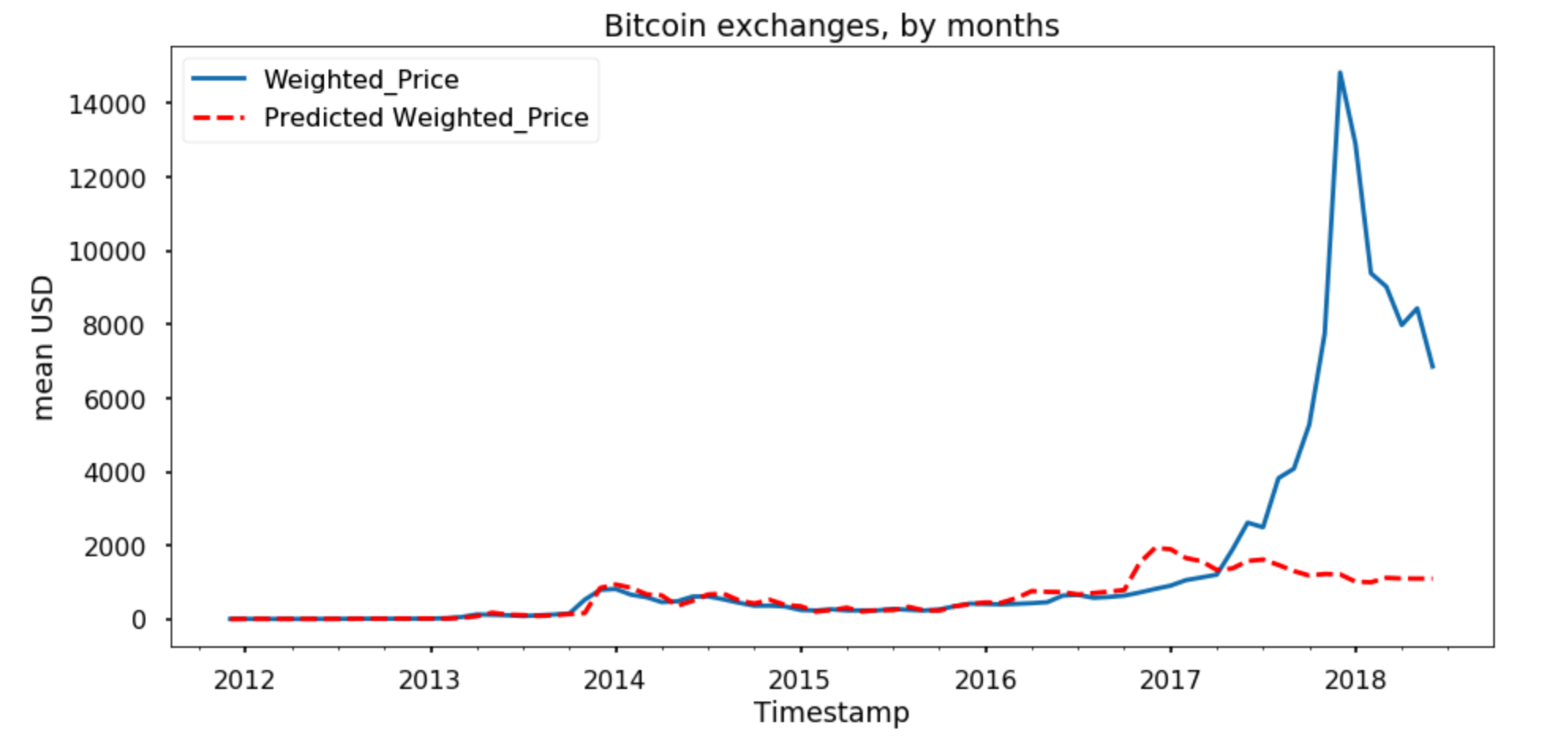
ARIMA RESULTS

Slide 17
RECURRENT NEURAL NETWORKS
A recurrent neural network is a class of artificial neural networks where connections between nodes form a directed or undirected graph along a temporal sequence.
RNNs use their internal state (memory) to process variable length sequences of inputs.
The term "recurrent neural network" is used to refer to the class of networks with an infinite impulse response, whereas "convolutional neural network" refers to the class of finite impulse response.
Both finite impulse and infinite impulse recurrent networks can have additional stored states, and the storage can be under direct control by the neural network.
The storage can also be replaced by another network or graph if that incorporates time delays or has feedback loops.
Such controlled states are referred to as gated state or gated memory and are part of long short-term memory networks (LSTMs) and gated recurrent units.
This is also called Feedback Neural Network (FNN).

Slide 18
LSTM AND GRU
Long short-term memory (LSTM)
It is an artificial recurrent neural network (RNN) architecture used in the field of deep learning (DL).
The main difference between an LSTM unit and a standard RNN unit is that the LSTM unit is more sophisticated.
More precisely, it is composed of the so-called feedback connections that supposedly regulate better the flow of information through the unit.
Gated recurrent unit (GRU):
The GRU is like a long short-term memory (LSTM) with a forget gate, but has fewer parameters than LSTM, as it lacks an output gate.
It intends to use connections through a sequence of nodes to perform machine learning tasks associated with memory and clustering.

Slide 19
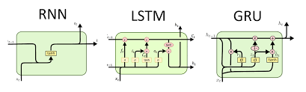
REPRESENTATION OF RNN, LSTM AND GRU

Slide 20
RNN IMPLEMETATION
Steps followed:
The dataset is loaded and fixed random seed for reproducibility.
Now, the dataset is loaded as ‘float64’ type and reshaped.
Later, the dataset is normalized using the MinmaxScalar() method.
The dataset is then split into training and testing datasets.
The input is then reshaped into samples, time steps and features.
Then the LSTM network is created and fitted into using keras.
The predictions are now made and inverted for best results.
The root mean square is then calculated where 2161.60 RMSE is the train score and 2118.96 RMSE is the test score.
The results are then plotted.

Slide 21
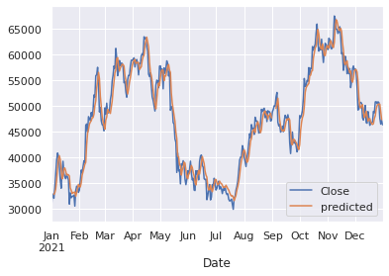
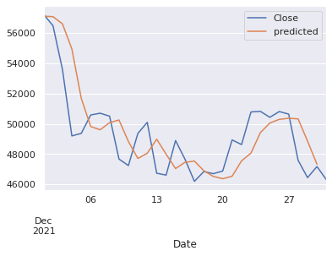
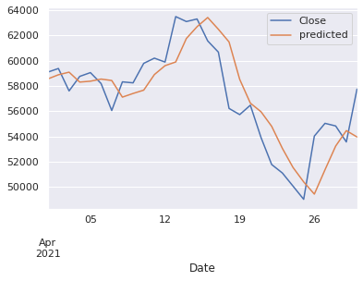
RESULTS FOR RNN:

Slide 22
FUTURE SCOPE
Include other models to compare the results, such as SARIMA, Facebook Prophet, among others.
We could also try GRU cells instead of LSTM for the RNN.
Include more features that influence BTC price. E.g.: some other stock exchange price, Twitter data, Whale data, altcoins data, active BTC addresses, etc.
Increase the number of datapoints by reducing the time intervals.
For this notebook, I used daily prices, but we could try with hourly prices for example.

Slide 23

ANY QUESTIONS?

